Slide 1
Redactie Portal
Meta Data

Slide 2
The Content
Live demonstration
What can you do with this Meta Data?
The Future

Slide 3
Web scraping
Omroep Flevoland
Instagram
Twitter
Facebook
News outlets
NOS
Whatsapp

Slide 4
What can you do with Metadata?
Find Connections between stories
Which Topics are relevant
Organizing resources
Finding relevant information
Predict trends
Fact Checking

Slide 5
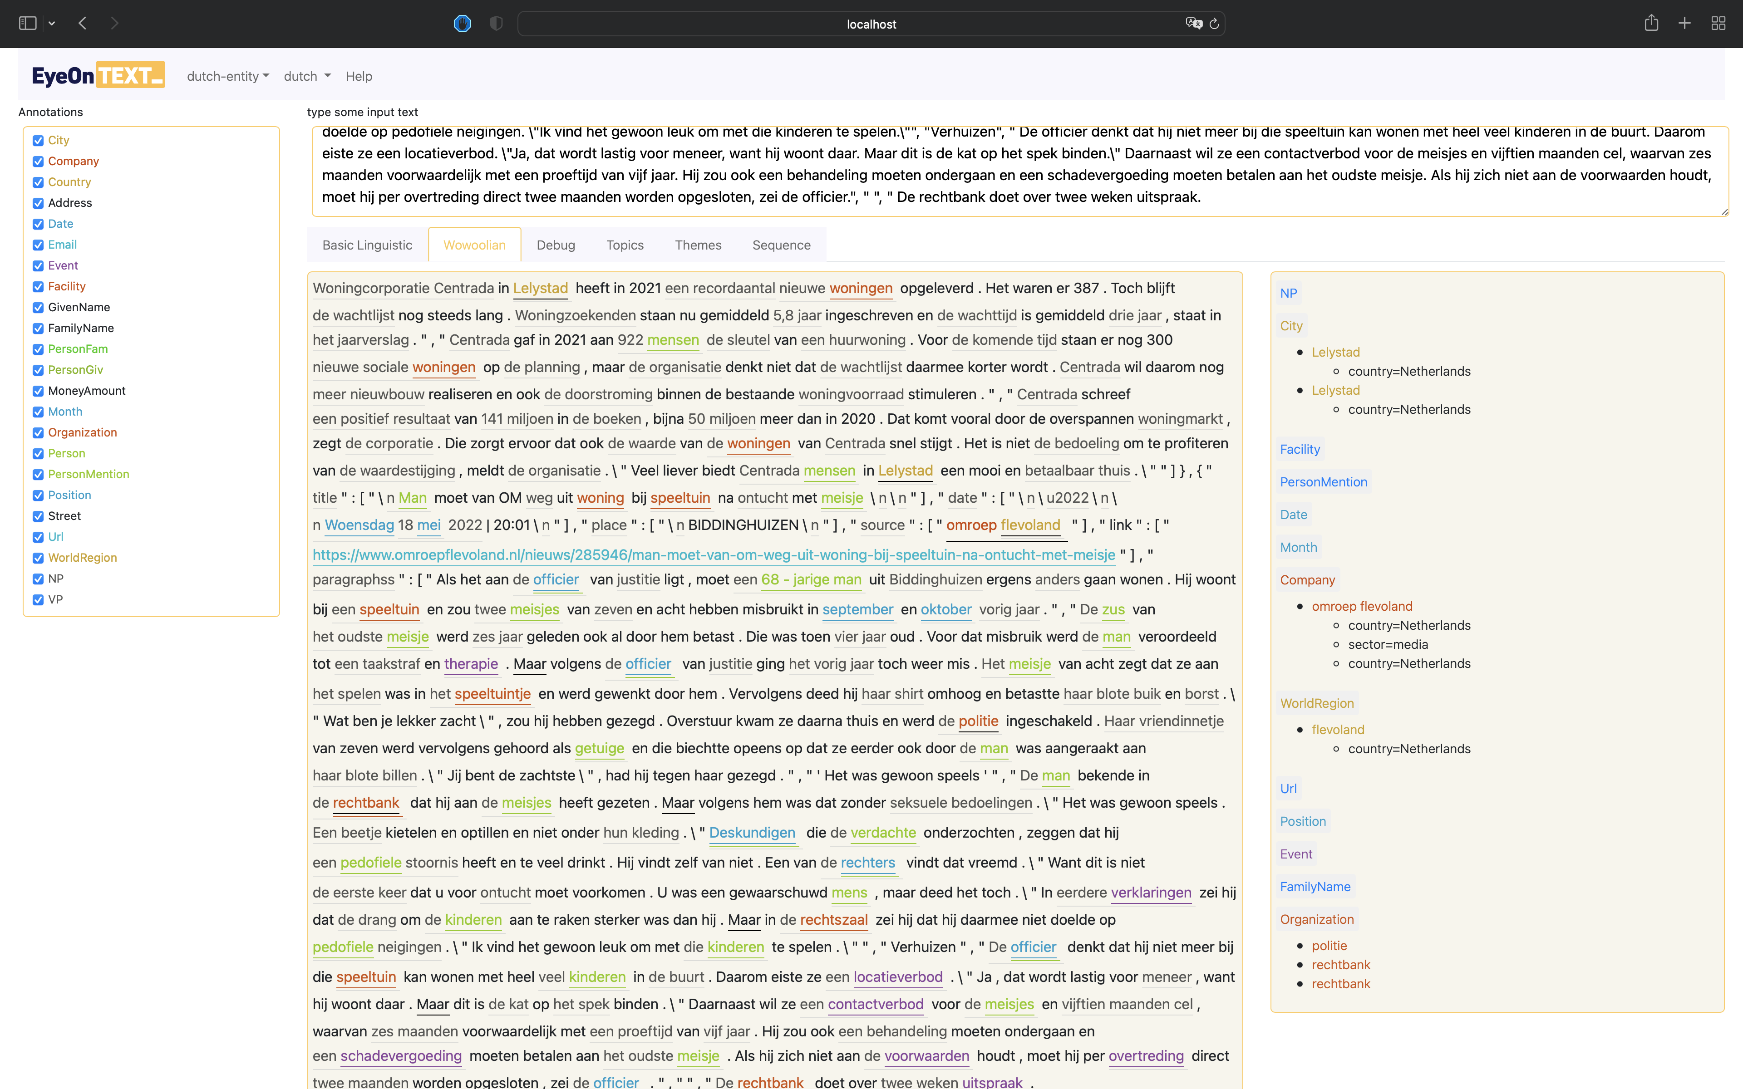

Slide 6
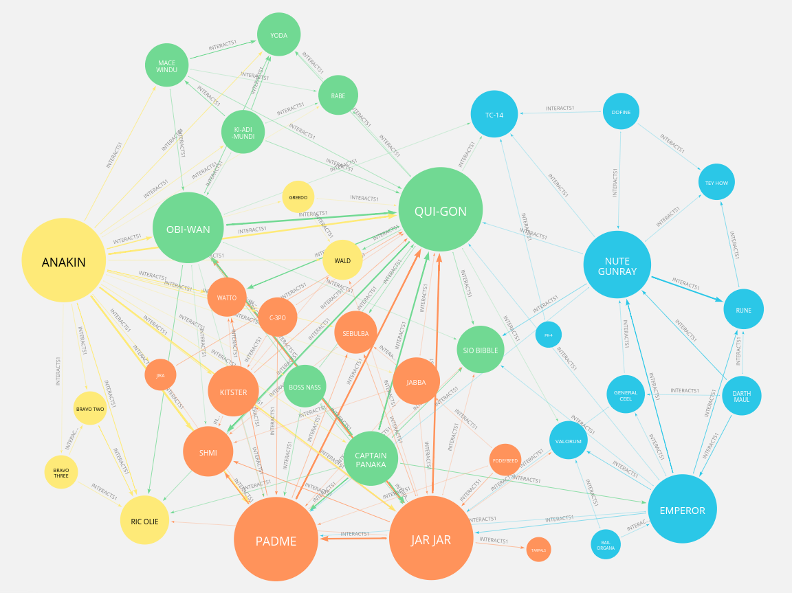

Slide 7
The Future
Project plan Redactieportal
Making the web scraper
Automate the process of getting metadata
Make more web scrapers
1
3
5
2
4
6
Research about NLP and webscraping
Make a Proof of concept
Make a Graph database of the gathered metadata

Slide 8
Thanks!
Any questions?

